Slide 1

E-commerce Analysis & Strategy Recommendations
Created by: Rupsa Chaudhuri

Slide 2
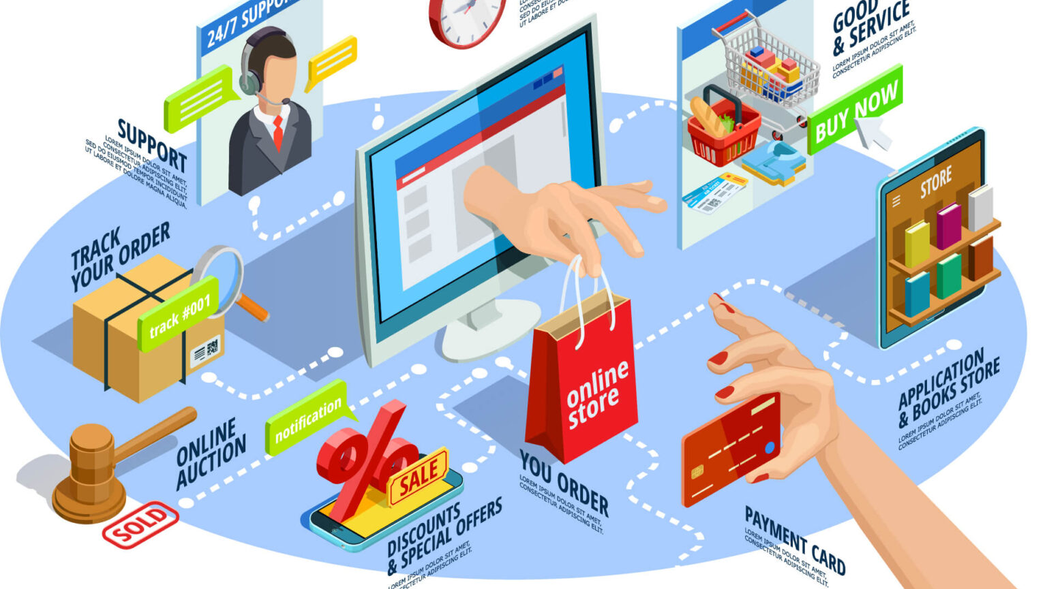
Index
Analyzing Traffic Sources
Analyzing Website Performance
Analysis for Channel Management
Business Patterns & Seasonality
Product Analysis
User Analysis
Recommended Strategies
Introduction
Timeline for Implementation

Slide 3
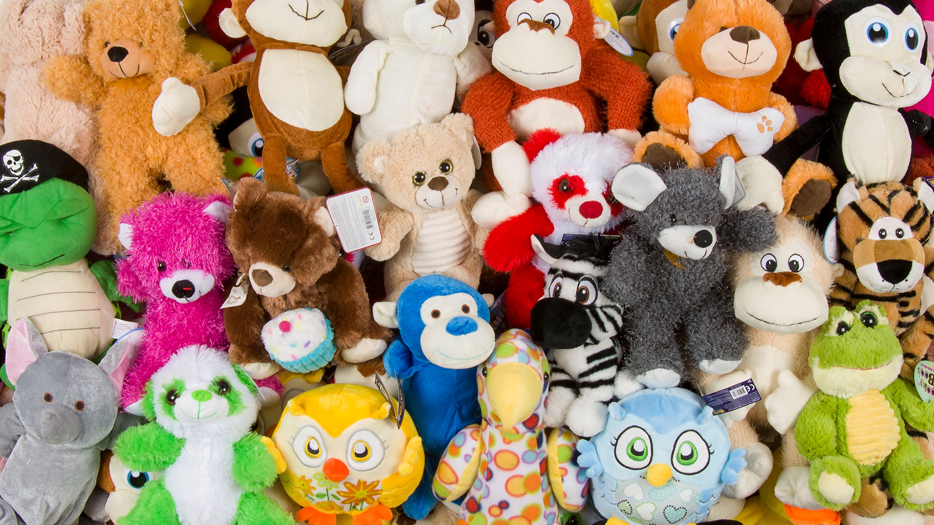
Introduction
Company Background: Established in 2012, this e-commerce business specializes in selling stuffed animals directly through their website. They've successfully launched four different stuffed animal dolls, with Mr. Fuzzy emerging as the most popular .
Company Objectives: The company prioritizes a data-driven approach to optimize its online presence. Leveraging website data from 2012-2014, their primary objectives for 2015 include:
Enhancing website performance: Improve mobile optimization, conversion funnels, and repeat customer strategy.
Increasing website traffic, sales, and revenue: This likely involves attracting new customers while also retaining existing ones.

Slide 4
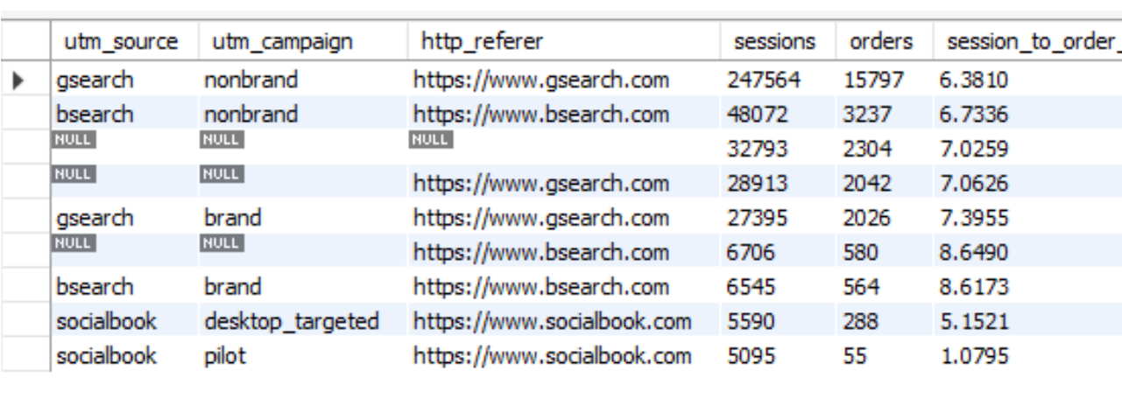
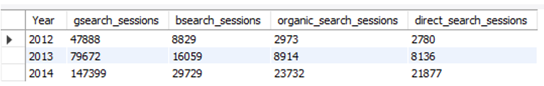
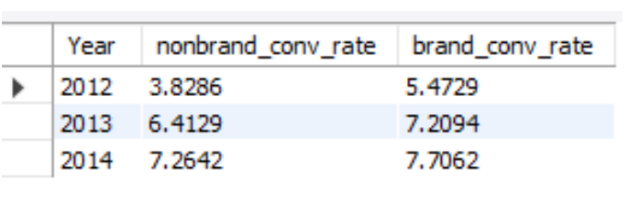
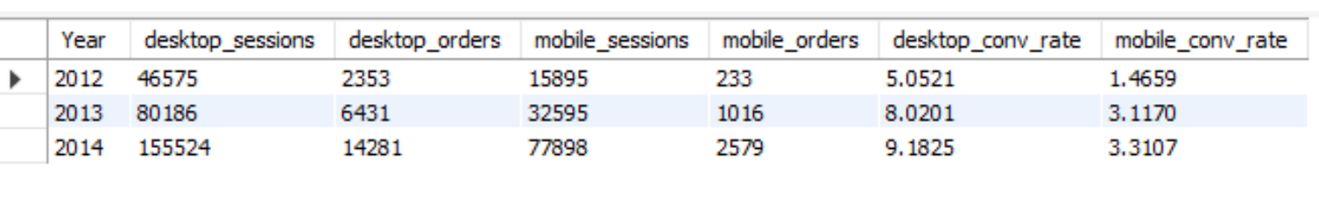
Analysing traffic sources
Gsearch non-brand is the top traffic driver (247,564 sessions).
Brand traffic on gsearch has a higher conversion rate (7.7%) than non-brand (7.26%) in 2014.
Organic search and direct search have good conversion rates at 8.6% and 7.02%.
Socialbook traffic has a low CVR at 5.15%, suggesting a need to bid down.
Desktop CVR(9.18% in 2014) is much higher than mobile CVR (3.3%).
Notes:
Gsearch non-brand traffic is the major driver with 247,564 sessions, followed by bsearch/non-brand with 48,072 sessions, and direct traffic with 32,793 sessions.
Gsearch traffic is dominant and shows a consistent increase in sessions throughout the year. Other channels (bsearch, organic, direct) also increased but are far behind gsearch.
For gsearch, brand traffic has a higher conversion rate (CVR) at 7.7% compared to non-brand traffic at 7.26% in 2014.
The CVR for organic search and direct search is good at 8.6% and 7.02%, respectively. Socialbook traffic has a lower CVR at 5.15%, suggesting it may be beneficial to bid down on socialbook.
The CVR for desktop users (9.18% in 2014) is significantly higher than for mobile users (3.3% in 2014). Increasing bids for desktop users could be advantageous.
4o
channel Performance and Strategy:
Gsearch Non-Brand Dominance: Non-brand traffic from Google Search (gsearch non-brand) significantly outperforms other channels in terms of sessions, indicating its importance as a primary traffic driver.
Device-Specific Conversion Rates: Desktop users exhibit substantially higher conversion rates compared to mobile users. Therefore, optimizing bids to favor desktop traffic could potentially yield higher conversion rates and better ROI.
Conversion Rate Insights:
Brand vs. Non-Brand CVR: Although brand traffic on Google Search (gsearch brand) has a slightly higher conversion rate than non-brand traffic, both contribute significantly to overall conversions. This suggests maintaining competitive bidding for both types of keywords but possibly focusing more on non-brand to increase market share.
Channel-Specific CVRs: Organic search and direct traffic show higher conversion rates compared to socialbook (assuming social media traffic). This indicates an opportunity to adjust bidding strategies to prioritize channels with higher conversion potential, while potentially reducing bids on social media traffic to optimize ROI.

Slide 5
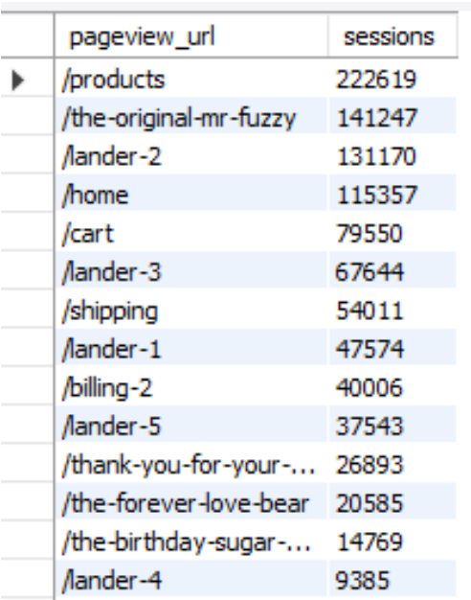
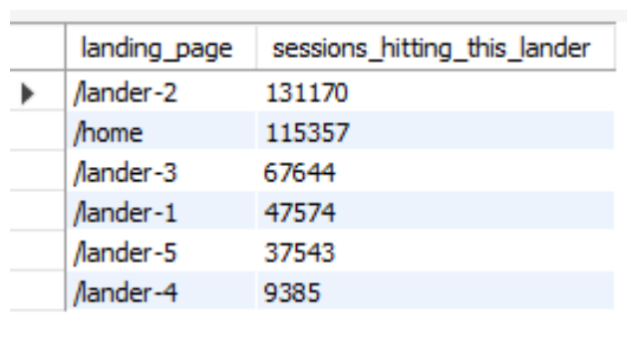
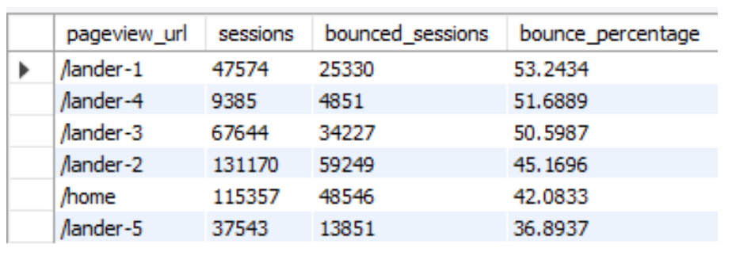
Analysing website performance
The /products page is the most visited with 222,619 sessions.
/lander-2 has high engagement with 131,170 sessions.
/lander-1 and /lander-4 have the highest bounce rates at 53.24% and 51.69%.
/lander-2 has a lower bounce rate at 45.17%.
Conversion Funnel (Non-branded Google Search Traffic for Mr. Fuzzy):
/lander-2 to /products: 64.8%
/products to Mr. Fuzzy page: 62.5%
Mr. Fuzzy page to cart: 57.6%
Cart to shipping page: 67.6%
Shipping page to billing page: 73.8%
Billing page to order placement: 67.2%
Notes:
High Traffic Pages:
The /products page is the most visited, indicating strong user interest in the product offerings.
The /the-original-mr-fuzzy page also receives significant traffic, suggesting Mr. Fuzzy is a popular product.
Engagement Levels:
The /lander-2 page has a substantial number of sessions and a lower bounce rate (45.17%) compared to /lander-1 and /lander-4, indicating it is more engaging and meets user expectations better.
The high bounce rates on /lander-1 and /lander-4 (53.24% and 51.69%, respectively) suggest these pages need improvement to retain user interest and reduce drop-offs.
Conversion Funnel Efficiency:
There is a good initial interest in Mr. Fuzzy, as evidenced by the high percentage of users progressing from the /lander-2 page to the products page (64.8%) and from the products page to the Mr. Fuzzy page (62.5%).
A significant number of users continue through the funnel, with 57.6% adding Mr. Fuzzy to the cart and 67.6% proceeding to the shipping page.
The conversion rate remains relatively high through the checkout process, with 73.8% moving to the billing page and 67.2% completing the order.
Recommendations:
Improve /lander-1 and /lander-4:
Analyze these pages to identify areas of improvement, such as clearer calls to action, better content, or more appealing design, to lower the bounce rates.
Leverage Successful Pages:
Use the successful elements of the /lander-2 page to enhance other landing pages, increasing overall engagement.
Optimize Conversion Funnel:
Continuously monitor and optimize the steps in the conversion funnel to maintain and improve the high conversion rates.
Address any potential drop-offs in the later stages of the funnel to further increase the order completion rate.

Slide 6
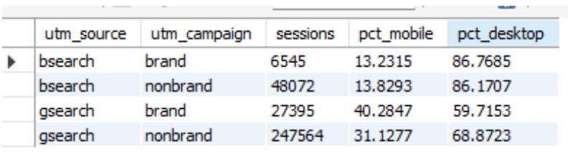
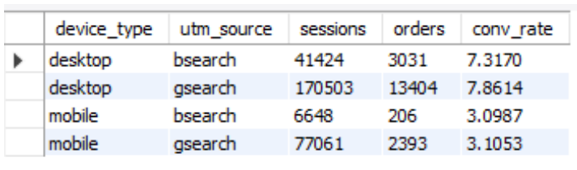
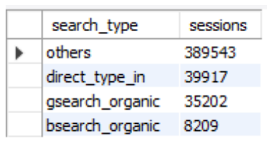
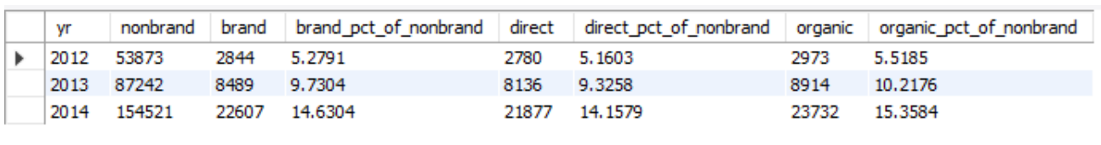
Analysis for channel management
Traffic Sources and Device Insights:
Traffic Sources:
GSearch drives most traffic, significantly more than BSearch.
Non-brand campaigns dominate traffic for both search engines.
Direct traffic: 39,917 sessions (not the largest source).
"Others" category: 389,543 sessions, which includes paid marketing.
Device Distribution:
Desktop leads in traffic, but mobile traffic is also significant.
BSearch has a higher desktop share compared to GSearch.
Conversion Rates:
Desktop Conversions:
GSearch: 7.86%
BSearch: 7.32%
Mobile Conversions:
GSearch: 3.10%
BSearch: 3.09%
Notes:
Traffic Sources and Device Insights:
Traffic Sources:
GSearch (Google Search) is the primary driver of traffic to the website, significantly outperforming BSearch (Bing Search).
Non-brand campaigns dominate traffic for both GSearch and BSearch, indicating users are primarily discovering the site through generic keywords rather than branded searches.
Direct Traffic: Accounts for 39,917 sessions, indicating a moderate level of brand recognition and direct engagement.
"Others" Category: The largest traffic source with 389,543 sessions, likely encompassing paid marketing efforts and other miscellaneous traffic sources.
Device Distribution:
Desktop Traffic: Leads in overall sessions, suggesting that a significant portion of users prefer using desktop devices to interact with the website.
Mobile Traffic: Although substantial, it is lower in session count compared to desktop. This is an important area for potential growth and optimization.
BSearch vs. GSearch Device Share: BSearch has a higher share of desktop traffic compared to GSearch, indicating different user behavior or demographics between the two search engines.
Conversion Rates:
Desktop Conversions:
GSearch: 7.86%
BSearch: 7.32%
Desktop conversions are relatively high for both search engines, showing that desktop users are more likely to complete purchases or desired actions.
Mobile Conversions:
GSearch: 3.10%
BSearch: 3.09%
Mobile conversions are significantly lower than desktop, highlighting a gap in the user experience or other barriers to mobile conversions.
Recommendations:
Prioritize Mobile Optimization:
Focus on improving the mobile user experience to address lower mobile conversion rates. his may involve optimizing page load times, simplifying navigation, and ensuring a seamless checkout process.
Analyze why BSearch has a lower share of mobile traffic compared to GSearch.
Bid Adjustments:
Increase bids for both GSearch and BSearch on desktop due to high and similar conversion rates.
Organic Search Optimization:
Enhance efforts in organic search optimization.This involves optimizing for relevant keywords, creating high-quality content, and ensuring technical SEO best practices are followed.
Invest in brand-building activities that can enhance brand recognition and drive more direct traffic. This could include content marketing, social media engagement, and PR efforts.
Analyze Paid Traffic:
Investigate reasons behind lower conversion rates for paid brand search.
Recognize the influence of paid marketing on brand awareness, as it may lead to direct traffic later. This suggests that even if paid traffic does not convert immediately, it has a long-term impact on user behavior and brand recognition.
Focus Areas:
Since non-brand paid campaigns drive the most traffic, maintaining and optimizing these campaigns should remain a priority.
Improve strategies to convert organic and direct traffic similar to paid brand search.

Slide 7
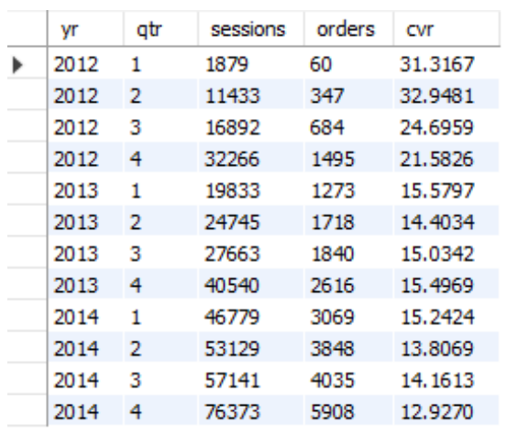
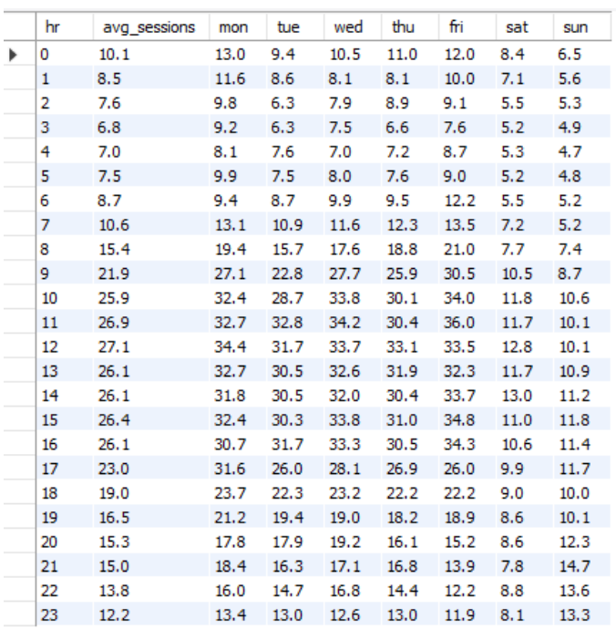
Business patterns & seasonality
Conversion Rate and Traffic Trends:
Conversion Rate (CVR) Decline:
CVR has decreased significantly from 31.3% to 12.9% since launch (2012-2014).
Sessions and Orders Increase:
Despite the lower CVR, the number of sessions and orders has increased, indicating that more users are visiting the site.
Holiday Season Spike:
There is a notable increase in sessions during the 4th quarter (holiday season).
Traffic Patterns:
Weekday Traffic:
Traffic peaks during business hours (8 AM - 5 PM), with a noticeable lunchtime rush (12 PM - 1 PM).
Weekdays have higher traffic compared to weekends.
Mondays have slightly lower traffic than other weekdays.
Fridays might experience slightly higher traffic than other weekdays.
Weekend Traffic:
Weekends generally see lower traffic compared to weekdays.
Notes:
Conversion Rate and Traffic Trends:
Conversion Rate (CVR) Decline:
CVR Trend: The conversion rate has decreased significantly from 31.3% at launch to 12.9% by 2014. This decline indicates that while more users are visiting the site, a smaller percentage are completing desired actions (such as purchases).
Sessions and Orders Increase:
Increased Sessions and Orders: Despite the lower CVR, the overall number of sessions and orders has increased. This suggests that the website is attracting more users over time, even though fewer of them are converting.
Holiday Season Spike:
4th Quarter Surge: There is a notable increase in sessions during the 4th quarter, likely due to the holiday season. This period sees a significant spike in user activity.
Recommendations:
Investigate CVR Decline:
Analysis Needed: It’s crucial to understand the reasons behind the declining CVR. This may involve analyzing user behavior, identifying potential barriers to conversion, and reviewing changes in the website or marketing strategies since launch.
Optimize Marketing for Peak Seasons:
Enhanced Holiday Marketing: Given the spike in sessions during the holiday season, it's important to optimize marketing campaigns to fully leverage this peak period. This could involve targeted promotions, holiday-themed content, and special offers.
Focus on Conversion Efficiency:
Balancing Traffic and Conversions: While attracting more users is beneficial, it's equally important to improve the efficiency of conversions. Strategies might include optimizing landing pages, simplifying the checkout process, and personalizing user experiences.
Traffic Patterns:
Weekday Traffic:
Business Hours Peak: Traffic is highest during business hours (8 AM - 5 PM), with a particularly busy period during lunchtime (12 PM - 1 PM).
Weekday vs. Weekend: Weekdays generally see higher traffic compared to weekends, indicating that users are more active during the workweek.
Daily Variations: Mondays have slightly lower traffic, while Fridays may experience slightly higher traffic than other weekdays.
Weekend Traffic:
Lower Traffic: Traffic tends to be lower on weekends compared to weekdays, suggesting that users are less engaged during their off days.
Recommendations:
Allocate Support Staff:
Strategic Staffing: Increase the number of support staff available during peak traffic times on weekdays, especially during business hours and lunchtime. This ensures that user queries and issues are addressed promptly, potentially improving user satisfaction and conversion rates.

Slide 8
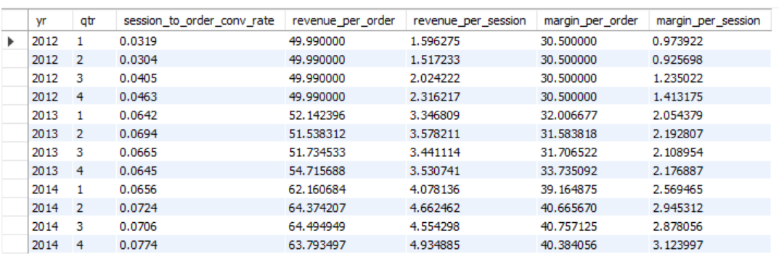
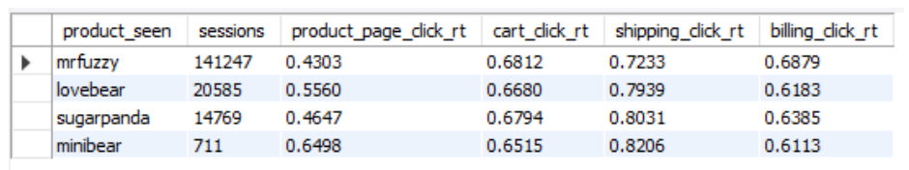
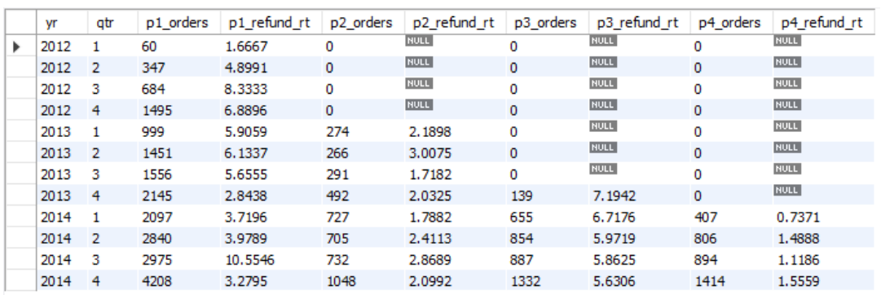
Product Analysis
Revenue, Margin, and Conversion Rates:
Growth: Revenue, margin, and conversion rates have increased consistently from 2012 to 2014.
Drivers: Higher conversion rates and increased traffic have boosted revenue and margin.
Performance: Strong customer acquisition and revenue generation.
Product Funnel Performance:
Mr. Fuzzy: High brand awareness, but low click-through rates.
Love Bear & Sugar Panda: Strong click-through rates, indicating effective funnels.
Mini Bear: Low click-through rates, needing funnel optimization.
Refund Rates:
Product 1: Highest refund rate, especially in Q3 of 2012 and 2014. Needs investigation.
Product 2 & 4: Low refund rates, indicating good performance.
Product 3: Initially high refund rates, decreasing over time.
Notes:
Revenue, Margin, and Conversion Rates:
Consistent Growth:
Increase in Key Metrics: Revenue, margin, and session-to-order conversion rates have all shown consistent growth from 2012 to 2014. This indicates a positive trend in the website's financial performance and user engagement.
Drivers of Growth:
Higher Conversion Rates: The improvement in conversion rates means that a larger percentage of visitors are completing purchases.
Increased Traffic: More users are visiting the website, contributing to the overall increase in orders and revenue.
Overall Performance:
Strong Customer Acquisition: The website is successfully attracting more users.
Revenue Generation: The combination of higher traffic and improved conversion rates is driving significant revenue growth.
Product Funnel Performance:
Mr. Fuzzy:
Brand Awareness: Mr. Fuzzy has the highest number of sessions, indicating strong brand recognition.
Funnel Optimization Needed: Despite high awareness, the lower click-through rates in the funnel suggest potential issues in user engagement or the funnel process that need addressing.
Love Bear:
Strong Click-Through Rates: Love Bear shows high click-through rates throughout the funnel, suggesting an effective user experience and well-optimized marketing efforts.
Sugar Panda:
Effective Funnel: Similar to Love Bear, Sugar Panda also has good click-through rates, indicating that the funnel process is effective.
Mini Bear:
Optimization Opportunity: The lower click-through rates for Mini Bear suggest that there are opportunities to optimize the funnel and improve user engagement.
Refund Rates Analysis:
Product 1:
High Refund Rates: This product has the highest refund rate, particularly noticeable in Q3 of 2012 and 2014. This warrants further investigation into customer feedback, product quality, or changes made during those periods.
Product 2:
Consistently Low Refund Rates: Product 2 performs well with low refund rates, indicating strong customer satisfaction and product reliability.
Product 3:
Improving Refund Rates: Initially high refund rates have been decreasing over time, suggesting successful improvements in the product or customer service.
Product 4:
Low Refund Rates: Similar to Product 2, this product maintains low refund rates, indicating good performance and customer satisfaction.
Recommendations:
Funnel Optimization:
Mr. Fuzzy and Mini Bear: Analyze user behavior to identify and address the factors contributing to lower click-through rates. Implement changes to improve the funnel efficiency for these products.
Reduce Refund Rates:
Product 1: Conduct a detailed analysis of customer reviews and product changes, especially for Q3 of 2012 and 2014, to identify issues leading to high refund rates. Take targeted actions to improve product quality and customer satisfaction.
Customer Feedback: Continually monitor and respond to customer feedback for all products to maintain and improve performance.
By focusing on these recommendations, the website can continue to grow its revenue and margins, enhance customer acquisition and satisfaction, and improve overall conversion rates across all products.

Slide 9
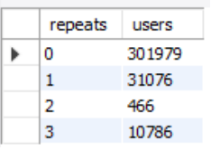

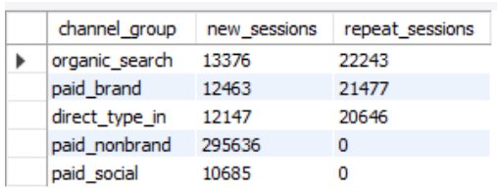
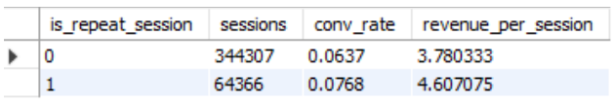

User Analysis
Visitor Patterns:
New Visitors: Majority are new, with significantly fewer third-time visitors compared to second-time and fourth-time visitors.
Repeat Behavior: Some revisit immediately; on average, repeat visitors return after a month.
Channel Performance:
Top Channels for Repeat Visitors: Organic search, paid brand, and direct type-in.
Lower Repeat Sessions: Paid non-brand and paid social.
Conversion and Revenue:
Higher Conversion Rates: Repeat visitors have higher conversion rates and spend more per session.
Customer Lifetime Value (CLTV): High CLTV of USD 1433.91 per year, indicating strong customer relationships.
Notes:
Visitor Patterns:
New Visitors:
Majority New: The website sees a significantly higher number of new visitors compared to repeat visitors. This indicates strong initial attraction but highlights a need to convert these visitors into repeat customers.
Repeat Visitor Behavior:
Third Visit Drop-Off: There are significantly fewer visitors on their third visit compared to both second-time and potentially fourth-time visitors. This suggests a critical drop-off point that needs addressing.
Immediate Revisit: Some users return almost immediately the next day, showing immediate interest.
Average Return Time: On average, repeat visitors return after about a month (33.82 days), with the longest time between the first and second visit being 69 days. This indicates a varying engagement pattern among repeat visitors.
Channel Performance:
Top Channels for Repeat Visitors:
Organic Search: The leading source for repeat visitors, indicating the importance of SEO and organic content in driving repeat traffic.
Paid Brand and Direct Type-In: These channels also drive significant repeat traffic, showing the effectiveness of brand recognition and direct engagement.
Lower Repeat Sessions:
Paid Non-Brand and Paid Social: These channels have lower repeat session counts, suggesting they are less effective in bringing users back to the site.
Conversion and Revenue:
Higher Conversion Rates for Repeat Visitors:
Better Performance: Repeat visitors have higher conversion rates and spend more per session than new visitors. This suggests they are more likely to make purchases and generate higher revenue.
Reasons for Higher Conversion: Factors likely include brand familiarity, greater engagement, and trust built from previous experiences.
Customer Lifetime Value (CLTV):
High CLTV: The average CLTV is USD 1433.91 per year per user, indicating that repeat customers generate significant revenue over time. This reflects strong customer relationships and potential for recurring revenue.
Recommendations:
Retention Strategies:
Convert New to Repeat: Focus on strategies to convert new visitors into repeat customers, such as targeted marketing campaigns, personalized content, and loyalty programs.
Engage After Second Visit: Pay particular attention to keeping users engaged after their second visit to prevent drop-off before the third visit.
Analyze and Segment Repeat Visitors:
Behavior Analysis: Analyze user behavior and segment repeat visitors to understand their browsing patterns and preferences.
Tailored Strategies: Use this information to tailor strategies that keep them engaged and encourage repeat purchases, thereby increasing customer loyalty and revenue.
Optimize Channels:
Focus on Effective Channels: Enhance efforts in organic search, brand awareness, and direct type-in visits, as these channels are more likely to drive repeat traffic.
Improve Lower Performing Channels: Investigate and implement improvements for paid non-brand and paid social channels to increase their effectiveness in driving repeat visits.
Leverage Repeat Visitors:
Maximize Potential: Focus on nurturing relationships with repeat visitors due to their higher conversion rates and spending.
Build Trust and Familiarity: Leverage the trust and familiarity these visitors have with the brand to maximize their lifetime value and encourage more frequent purchases.
By implementing these recommendations, the website can improve its ability to retain new visitors, enhance the effectiveness of its marketing channels, and increase overall revenue through higher conversion rates and stronger customer loyalty.

Slide 10
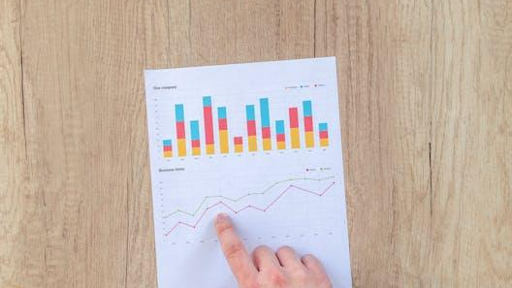
Recommended Strategies
Enhanced User Experience:
Optimize mobile and desktop experiences for better site performance and navigation.
Improve landing pages to reduce bounce rates, focusing on key pages like /lander-1 and /lander-4.
Conversion Funnel Optimization:
Streamline checkout processes and enhance key pages such as /products and Mr. Fuzzy for improved engagement and conversion rates.
Data-Driven Marketing:
Implement targeted retention strategies to convert new visitors into repeat customers.
Optimize marketing channels based on performance insights, focusing on desktop traffic and refining social media strategies.
Operational Excellence and Investor Appeal:
Enhance customer support during peak times to improve user satisfaction.
Address product quality issues to reduce refund rates and enhance customer experience.
Showcase financial health and growth potential to attract investors, emphasizing strong revenue growth and customer loyalty metrics.
Notes:
Enhance User Experience
Mobile Optimization:
Improve mobile site performance to increase conversion rates (CVR) by optimizing page load times, simplifying navigation, and ensuring a seamless checkout process.
Desktop Experience:
Given the higher CVR on desktop, ensure the desktop experience remains robust. Consider adding more personalized and engaging content for desktop users.
Landing Page Improvements:
Analyze high bounce rates on pages like /lander-1 and /lander-4 to identify and address issues. Use successful elements from /lander-2 to enhance these pages.
2. Conversion Funnel Optimization
Optimize Key Pages:
Focus on the /products page and the Mr. Fuzzy page to enhance user engagement and drive conversions. Ensure that these pages are intuitive, fast, and visually appealing.
Refine Conversion Steps:
Continuously monitor and optimize each step in the conversion funnel to minimize drop-offs. Simplify the checkout process and offer incentives for completing purchases.
3. Data-Driven Marketing Strategies
Retention Campaigns:
Develop targeted campaigns to convert new visitors into repeat customers. Use personalized emails, retargeting ads, and loyalty programs to re-engage past visitors.
Channel Optimization:
Increase bids for desktop traffic on GSearch and BSearch due to their higher conversion rates. Adjust bidding strategies to prioritize high-performing channels like organic search and direct type-in traffic.
Social Media Strategy:
Reassess the performance of socialbook (social media) campaigns. Consider reducing bids or reallocating budget to higher-performing channels.
4. Customer Insights and Personalization
Behavior Analysis:
Segment repeat visitors to understand their browsing patterns. Use this data to personalize user experiences and marketing messages, enhancing engagement and loyalty.
Feedback and Reviews:
Regularly analyze customer reviews and feedback to identify areas for product and service improvement. This is particularly important for products with high refund rates.
5. Product-Specific Strategies
Mr. Fuzzy and Mini Bear:
Investigate and address the reasons behind lower click-through rates in the funnel. Improve product descriptions, images, and user reviews to enhance appeal.
Love Bear and Sugar Panda:
Leverage the strong performance of these products to cross-sell and upsell related products.
6. Marketing and Brand Building
SEO and Content Marketing:
Invest in organic search optimization by creating high-quality, keyword-rich content. Maintain a blog or resource center to attract and retain users.
Brand Awareness:
Enhance brand recognition through content marketing, social media engagement, and PR efforts. Highlight customer success stories and testimonials.
Seasonal Campaigns:
Capitalize on the spike in traffic during the holiday season with targeted promotions, holiday-themed content, and special offers.
7. Investor Attraction Strategies
Demonstrate Growth Potential:
Present consistent growth in sessions, revenue, and conversion rates to potential investors. Highlight the significant increase in key metrics over the years.
Showcase Customer Loyalty:
Emphasize the high customer lifetime value (CLTV) and strong repeat visitor performance. Demonstrate strategies in place to convert new visitors into loyal customers.
Financial Health and Projections:
Provide detailed financial reports and projections showing continued revenue growth, margin improvements, and return on investment (ROI) for marketing spend.
Innovative Initiatives:
Highlight innovative initiatives such as advanced analytics, personalized marketing, and new product launches to showcase the company’s forward-thinking approach.
8. Operational Improvements
Support Staff Allocation:
Increase support staff during peak traffic times on weekdays, especially during business hours and lunchtime, to improve user satisfaction and potentially increase conversions.
Product Quality and Refund Rate Management:
Investigate high refund rates for certain products, particularly Product 1. Take targeted actions to improve product quality and customer satisfaction, which can reduce refunds and increase repeat purchases.
By focusing on these strategies, the website can improve its performance, increase sales and revenue, and create a compelling case for attracting investors. Implementing these recommendations will ensure sustained growth, enhance customer satisfaction, and build a strong foundation for long-term success.

Slide 11
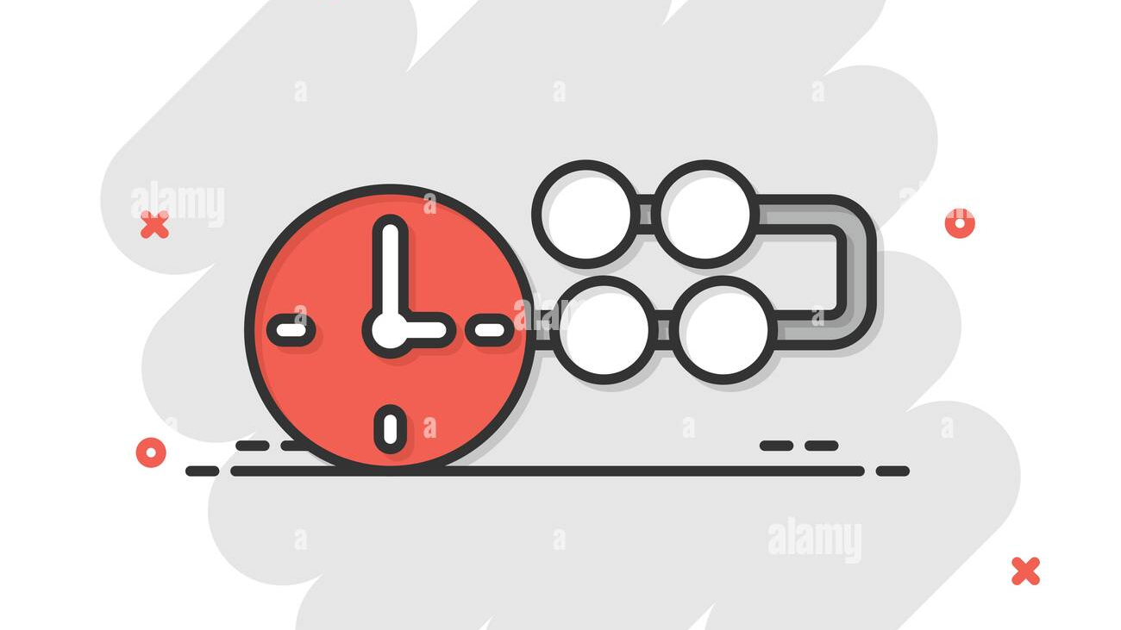
Timeline for implementation
Short Term (0-6 months):
Optimize UX (mobile/desktop).Improve /lander-1 and /lander-4.Streamline checkout, enhance /products and Mr. Fuzzy. Launch initial retention campaigns. Boost peak-hour support, address high refunds, prepare investor reports.
Mid Term (6-12 months):
Complete UX optimizations. Redesign /lander-1 and /lander-4.Refine checkout, scale retention, optimize marketing. Establish support protocols, continue quality improvements. Host investor updates on growth.
Long Term (12+ months):
Maintain UX optimizations. Evolve landing pages. Implement advanced checkout, enhance interactivity. Develop automated retention, explore new marketing. Establish AI-driven support, maintain high standards, sustain investor confidence.
Notes:
Short Term Goals (0-6 months)
Enhanced User Experience:
Mobile Optimization: Begin immediate improvements to mobile site speed and navigation.
Desktop Focus: Update existing desktop experience with personalized content and streamlined navigation.
Landing Pages: Conduct initial analysis of /lander-1 and /lander-4 to identify key improvements for reducing bounce rates.
Conversion Funnel Optimization:
Checkout Process: Streamline initial steps of checkout process to address immediate drop-off points.
Key Pages Enhancement: Begin iterative improvements on /products and Mr. Fuzzy pages to enhance engagement and conversion rates.
Data-Driven Marketing:
Retention Campaigns: Launch initial campaigns aimed at converting new visitors into repeat customers with personalized offers and follow-up emails.
Channel Optimization: Start refining bid strategies for desktop traffic on GSearch and BSearch; initiate adjustments to social media campaigns based on early performance insights.
Operational Excellence and Investor Appeal:
Customer Support: Increase support staff during identified peak hours to improve responsiveness and user satisfaction.
Product Quality: Begin initial investigations into high refund rates; implement early actions to address quality issues and customer feedback.
Investor Communication: Prepare and share current financial reports highlighting growth trends and customer loyalty metrics.
Mid Term Goals (6-12 months)
Enhanced User Experience:
Mobile Optimization: Complete comprehensive improvements to mobile site performance and usability.
Desktop Focus: Implement advanced personalization features and optimizations for desktop users.
Landing Pages: Implement redesigned versions of /lander-1 and /lander-4 based on user feedback and A/B testing results.
Conversion Funnel Optimization:
Checkout Process: Refine and optimize entire checkout process for smoother user experience and increased conversions.
Key Pages Enhancement: Roll out enhanced versions of /products and Mr. Fuzzy pages with improved UX/UI elements and content.
Data-Driven Marketing:
Retention Campaigns: Scale successful retention strategies; expand personalized marketing efforts to increase repeat customer engagement.
Channel Optimization: Further refine bidding strategies across all channels; optimize social media campaigns for improved ROI and audience engagement.
Operational Excellence and Investor Appeal:
Customer Support: Establish optimized support protocols and staffing based on ongoing analysis of peak traffic patterns.
Product Quality: Continue quality improvement initiatives; track and report progress on reducing refund rates.
Investor Engagement: Host investor updates and presentations showcasing mid-term growth metrics and strategic milestones.
Long Term Goals (12+ months)
Enhanced User Experience:
Mobile and Desktop: Maintain ongoing optimization efforts; incorporate user feedback and emerging technology trends.
Landing Pages: Establish continuous improvement cycles for all key landing pages based on performance data and user behavior analysis.
Conversion Funnel Optimization:
Checkout Process: Implement advanced features such as one-click checkout and personalized recommendations.
Key Pages Enhancement: Evolve pages to reflect market trends and customer preferences; integrate interactive elements to enhance user engagement.
Data-Driven Marketing:
Retention Campaigns: Mature automated retention strategies; implement advanced segmentation and predictive analytics for targeted marketing.
Channel Optimization: Maintain agility in bid management; explore emerging platforms and technologies for marketing outreach.
Operational Excellence and Investor Appeal:
Customer Support: Establish industry-leading customer support standards; integrate AI and automation for efficiency.
Product Quality: Achieve industry benchmarks for product reliability and customer satisfaction; leverage customer feedback for continuous improvement.
Investor Confidence: Showcase sustained revenue growth, strong customer loyalty metrics, and innovative initiatives to secure long-term investor confidence and support.
This timeline outlines a structured approach to implementing key strategies aimed at improving website performance, increasing sales and revenue, and attracting investors over the short, mid, and long term.

Slide 12
Thank you!
Email: rupsachaudhuri9@gmail.com
LinkedIn
GitHub

